Slide 1
MIA - Membership inference Attack

Slide 2
Privacy attacks in Machine learning models
We are very much aware of:
Data leaks and data breach
Privacy issues
Data miss usage for Business, etc
Now comes a new term:
Privacy issues in ML Models.
Notes:
Before going into the details, Let me quickly brief you on what is the basic motivation behind taking up this project.
If you look at the current advanced techno world, people were facing issues with data breaches and data leaks, and other data privacy concerns which We never really bothered about In the early phases of this huge technological advancement.
Similarly, (ML) is one of the fastest evolving fields, it is the current and future game-changing thing, it feels like each and everyday, there is a new tool emerging. So obviously we are very much fond of using all these tools and technologies to make our life easier. we eventually end up giving a lot of data away.
So, it is very important to recognize and consider the privacy issues in the ML Models.
We, in this project, have tried to show you that our privacy is at stake by conducting membership inference attacks on ML models.

Slide 3

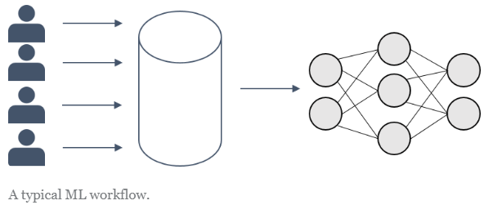
Basic Workflow of ML Models:
Notes:
It is very obvious everybody here is aware of basic workflow of ML model but, let me focus on a few spects in the outline to make you better understand MIA very clearly.
Let us say some potential attacker Oscar has broken into the system. Now the question here would be..,
what will Oscar be able to steal from this model? Is there a memory address in the model where the data is stored? Or anything like that? Well…. not exactly…. but let me explain how Oscar will use the basic workflow of an ML model to trick the model itself to extract the data.
Let’s assume you are trying to build a classifier, what we essentially do is, we start with the training data, set of features X catergorise as label Y. Then we use our training data to make the model learn how to map from x to y.
To learn a mapping from specific features to corresponding labels, the model needs to “remember” in its parameters some information about the data it was trained on. Otherwise, how would it come to correct conclusions about new and unseen data?
The fact that, some information about the training data is stored in the model parameters, might, however, cause privacy problems. This is because it enables someone with access to the ML model to deduct different kinds of information about the training data.

Slide 4
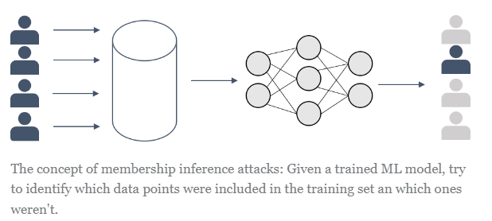
Introduction to MIA
MIA: Membership inference Attack.
Notes:
Now as we know the fact that some information about the training data is being stored in the model parameters, let us see how MIA comes into Play.
The basic concept of MIA is : Given a trained ML model, and some data point, if we can find out if this data point was part of the model’s training sample then basically we kind of broke into the system. It is a serious privacy concert. You might mot see the privacy concern yet but let me explain you using an example.

Slide 5






Oscar’s Master Plan
Bob
Bob plans on taking a Insurance and visit Oscar who works at Insurance Company
Oscar Oscar works at insurance company
Oscar performs Background verification on Alice, He performs Membership Inference Attack on ML model Bob has used in the past and finds that Bob is a Smoker.
Oscar decides on increasing Bob’s insurance because he’s a Smoker.

Slide 6
How our Membership Inference Attack Work?
Assumption : We have partial data that has been used in the target model we call it Member data. We also have partial Non Member data.
Target Model : It is an image classification model.
We are going to perform this Attack on the Target Model.
Now we create Shadow Models to classify Member data and Non Member data.

Slide 7
Shadow Models
We have created 7 different classifier models to perform this attack.
To create a shadow model we first pass the Member data and Non Member data into the target model and get the attributes of member data.
Let’s call them Member Attributes and Non Member Attributes.
Now we feed Member data Attributes and Non Member data Attributes into the shadow models and train the models to classify Member data attributes and Non member data Attributes.

Slide 8
Shadow Models
XGBoost classifier
Random Forest Classifier
Linear Regression
Perceptron
AdaBoostClassifier
Support Vector Machine
Hist Gradient Boosting Classifier
We are training and testing the classifiers which we created.
The main metric we are using here is f1 score.

Slide 9
F1 score
F1 score is a machine learning evaluation metric that measures a model's accuracy. It combines the precision and recall scores of a model.
The accuracy metric computes how many times a model made a correct prediction across the entire dataset.

Slide 10
F1 Scores of the Classifiers which we used.
Classifier | F1 Score for predicting 1’s
XGBoost Classifier | 0.71
Random Forest Classifier | 0.80
Linear Regression | 0.80
Perceptron | 0.68
AdaBoostClassifier | 0.80
Support Vector Machine | 0.80
Hist Gradient Boosting Classifier | 0.80

Slide 11
Our take on MIA
We have Tensorflow MIA and IBM Attack MIA models that use only one classifier and overfit the classifier to perform this Attack.
Here we are using the predictions of the 7 Classifiers to say if the data is Member or non Member. For example if 4 of 7 models say that the data point is is member we assume that that individual data point has been used in the training of the target model.
Mean accuracy of our attack : 64.85%

Slide 12
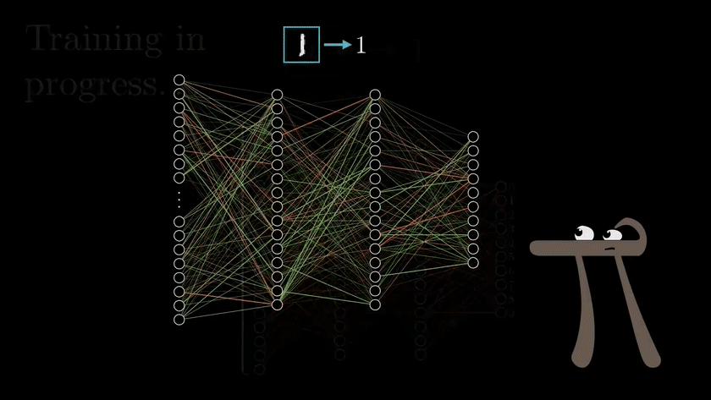

Slide 13
References
[1] Shokri, Reza, Marco Stronati, Congzheng Song, and Vitaly Shmatikov. “Membership inference attacks against machine learning models.” In 2017 IEEE Symposium on Security and Privacy (SP), pp. 3-18. IEEE, 2017.
[2] Song, Liwei, and Prateek Mittal. “Systematic evaluation of privacy risks of machine learning models.” arXiv preprint arXiv:2003.10595 (2020).
[3] Yeom, Samuel, Irene Giacomelli, Matt Fredrikson, and Somesh Jha. “Privacy risk in machine learning: Analyzing the connection to overfitting.” In 2018 IEEE 31st Computer Security Foundations Symposium (CSF), pp. 268-282. IEEE, 2018.
[4] Truex, Stacey, Ling Liu, Mehmet Emre Gursoy, Wenqi Wei, and Lei Yu. “Effects of differential privacy and data skewness on membership inference vulnerability.” In 2019 First IEEE International Conference on Trust, Privacy and Security in Intelligent Systems and Applications (TPS-ISA), pp. 82-91. IEEE, 2019.
[5] Salem, Ahmed, Yang Zhang, Mathias Humbert, Pascal Berrang, Mario Fritz, and Michael Backes. “Ml-leaks: Model and data independent membership inference attacks and defenses on machine learning models.” arXiv preprint arXiv:1806.01246 (2018).

Slide 14
Conclusion
It's important to be aware of membership inference attacks and take steps to protect data privacy. Limit data access, use differential privacy, and monitor output for suspicious behavior to reduce risk.
We need to stay informed and take appropriate action to defend against these attacks.
We need to be aware of these kind of attacks while using ML Models.
We all use Chat GPT and other models to make our life easier what if someone does these kind of attacks on those models. It would put our privacy at risk.

